Slide 1

PULSE Enhancing Elderly Care Through Advanced Technology

Slide 2
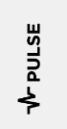


Elderly Population: Statistics in Ireland
50%
50% of people are worried about relatives living alone.
1.6m 65+
By 2051, 1.6 million people will be aged 65 & over.
74%
74% of adults aged over 58 report medical conditions.
189,574
Aged 65 & over living alone.

Slide 3




Challenges
Constant Health Concerns
Persistent concern revolves round not knowing their condition
Health Symptom Ignorance
Elderly often overlook symptoms failing to recognize the need for help
Emergency Contact uncertainty
In event of accident will they be able to reach out for help?.
Access to health care
Access to healthcare is difficult so to take preventative rather than reactive action is difficult

Slide 4
Weaknesses of Current Solutions
In home Falling Monitoring Systems
Weakness: Only alerts when patient has fallen down
01
Checking in
Weakness: Unreliable - patient is not always near phone
02
Wearable devices
Weakness: Reactive - Only alerts when problems have already arisen
03

Slide 5



Our Solution
Real-time health monitoring wearable technology.
Using:
AI
5G
And sensors
we will solve these challenges to prevent and predict healthcare issues within the elderly demographic.

Slide 6
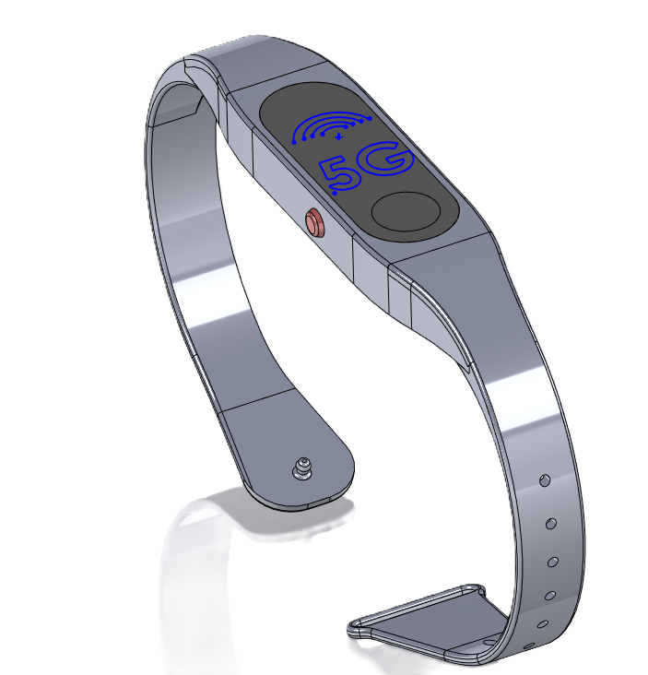
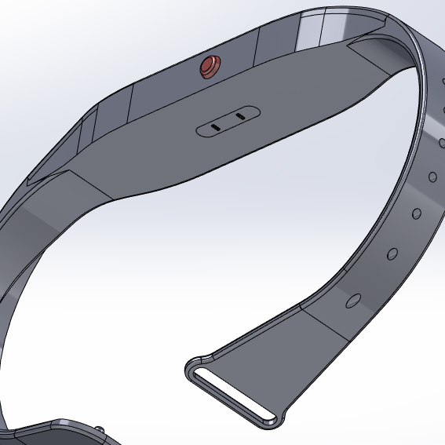
Technology Overview Our solution
AI Algorithms
Analyzing data over time helps predict future health issues and generate personalized alerts.
Our solution utilities technology that already exists in other products.
Sensors
Collect data from sensors such as heart rate, temperature ext.
5G
5G ensures real-time data transmission to the caregiver's phone for instant visualization.

Slide 7









Marketing PULSE
Social Media
Using targeted ad on Facebook, Instagram ext. These ads can target our demographic of carers and family members
Social Media
Partnerships
Partnerships
Collaborations with healthcare providers, charities for the elderly
Marketing
PR
Engaging with media outlets to share successful stories about the effectiveness and positive outcomes of the system
PR

Slide 8



Revenue Model
Reduced Subscription
Reduced price for first 6 months is incentive and ensures customers will use service long enough to experience long term benefits.
2
1
3
Initial Price
Fee to cover cost of manufacturing watch. Low price is an incentive to choose this system over others.
Full Subscription Fee
Full fee is charged to cover computing cost & maintenance cost.

Slide 9


Distribution Model
E-commerce Platforms
Specialized medical equipment website
Direct to Consumer Sales
Online sales through company’s website
Insurance Companies
Partnerships with companies to offer discounts to adopt this system

Slide 10

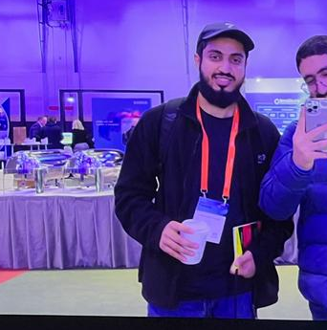



Our Team
Duana Ni Computer Science Graduate
Niall Bastible Diaz Computer Science Student
Mohammed Al Shuaili Electronic & Computer Engineering Student
Marjia Siddik Computer Science Student
Ugochi Eze-Ejikeme Electronic & Computer Engineering Student
Ali Ahmad Computer Science Student

Slide 11
THANK YOU!

Slide 12

Demonstrational Video
Our Solution

